Slide 1

6th Grade Math
Unit 7, Lesson 7 Subtracting Integers Using Integer Chips Volume 2, pg. 32

Slide 2


Benchmark
MA.6.NSO.4.1
Apply and extend previous understandings of operations with whole numbers to add and subtract integers with procedural fluency.
volume 2, pg. 32

Slide 3
Integrated Mathematical Thinking and Reasoning Standards
MA.K12.MTR.2.1 Demonstrate understanding by representing problems in multiple ways.
MA.K12.MTR.5.1 Use patterns and structure to help understand and connect mathematical concepts.
volume 2, pg. 32

Slide 4

Learning Target
I can use integer chips to subtract integers.
volume 2, pg. 32

Slide 5

Warm-Up
volume 2, pg. 33

Slide 6

7.7.1 Warm-Up: When Will I Use This?
The speaker states, “It’s not about what you learn, it’s about what methods, tools, and tactics you have to develop in order to solve the problem that you may never see again for the rest of your life …” What does he mean by “methods, tools, and tactics”?
volume 2, pg. 33

Slide 7
The quote continues to say, “… but you will see other problems where these methods and tools will become immensely valuable to you.” Where might these methods, tools, and tactics help you in everyday life?
volume 2, pg. 33

Slide 8

Exploration
volume 2, pg. 33

Slide 9

7.7.2 Exploration: Subtracting Integers
In the first column, a larger circle represents a number that has a larger absolute value than that of the smaller circle. Without discussing it with your partner, enter a numeric example for each visual model. Then, in the “My Guess: Answer Will be + or −” column, enter whether you think the result will be positive (+) or negative (−).
After completing all of your own examples and guesses, record your partner’s examples and guesses.
volume 2, pg. 33

Slide 10
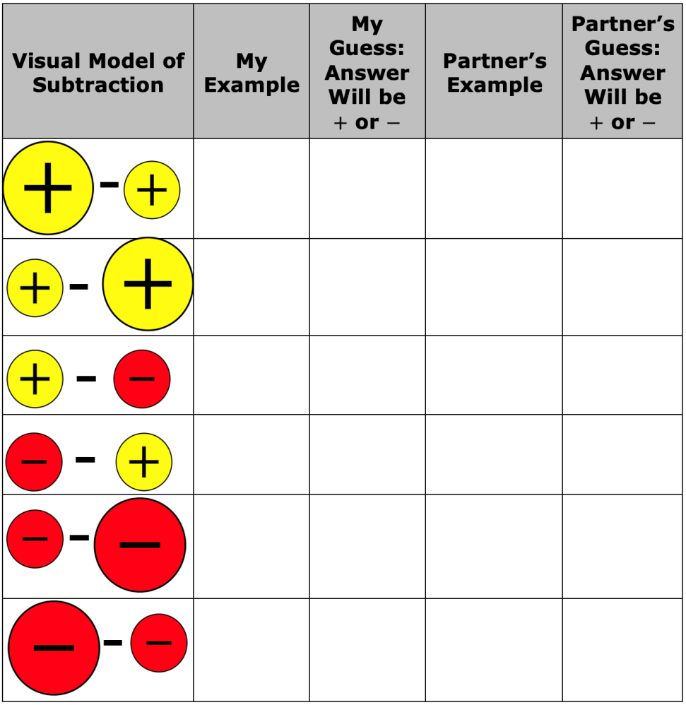
volume 2, pg. 33

Slide 11
Now, form a group of four by joining another pair of classmates. Discuss your guesses. Do all four of you agree on all of the problems? If not, list which problems you disagree on.
volume 2, pg. 34

Slide 12
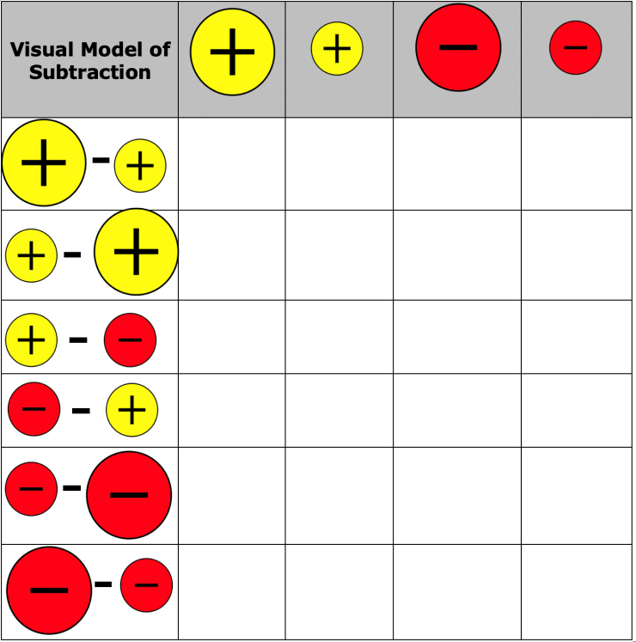
0
Tell your teacher when you are ready to test out the guesses with a calculator. Use the calculator to find the answer for one problem from each visual model. When each of you are in agreement with the rule, check the box in the column that represents the answer.
volume 2, pg. 34

Slide 13

Guided Instruction
volume 2, pg. 34

Slide 14


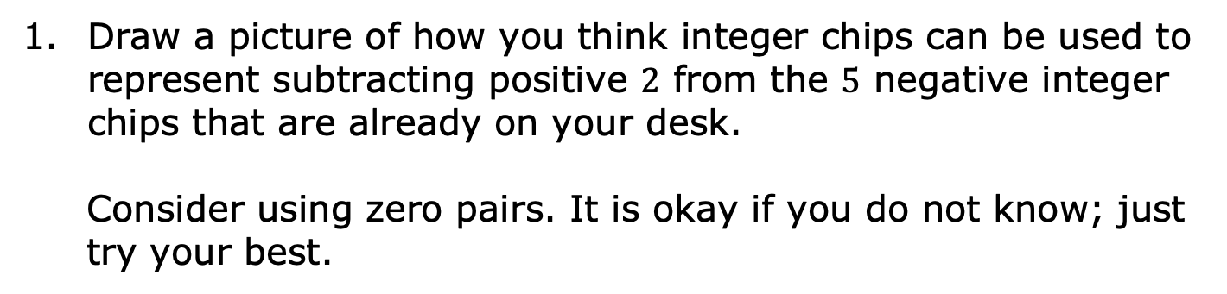
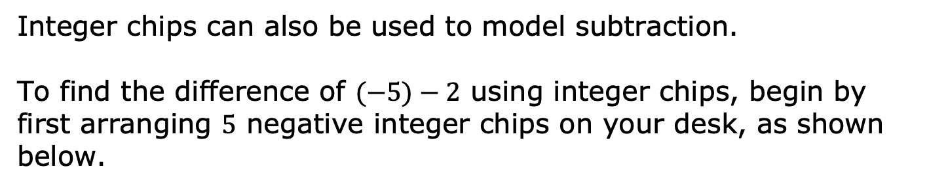
7.7.3 Guided Instruction: Using Integer Chips to Show Subtraction
Integer chips can also be used to model subtraction.
To find the difference of $(−5)−2$ using integer chips, begin by first arranging $5$ negative integer chips on your desk, as shown below.
Draw a picture of how you think integer chips can be used to represent subtracting positive $2$ from the $5$ negative integer chips that are already on your desk.
Consider using zero pairs. It is okay if you do not know; just try your best.
volume 2, pg. 34

Slide 15

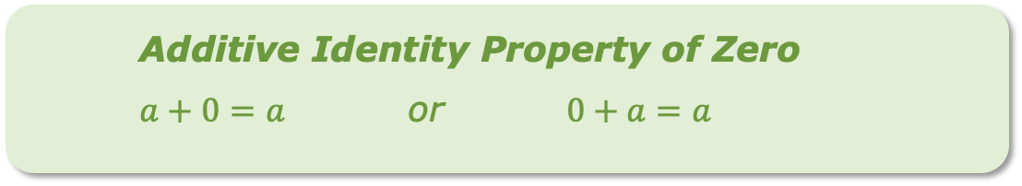
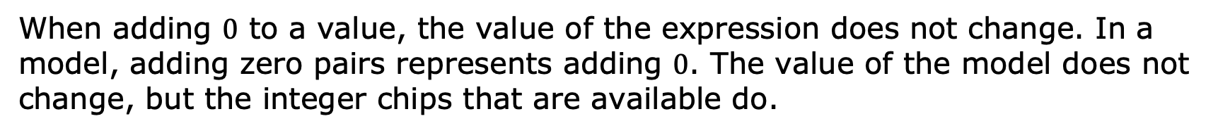
Additive Identity Property of Zero
$a+0=a$ or $0+a=a$
When adding $0$ to a value, the value of the expression does not change. In a model, adding zero pairs represents adding $0$. The value of the model does not change, but the integer chips that are available do.
volume 2, pg. 34

Slide 16

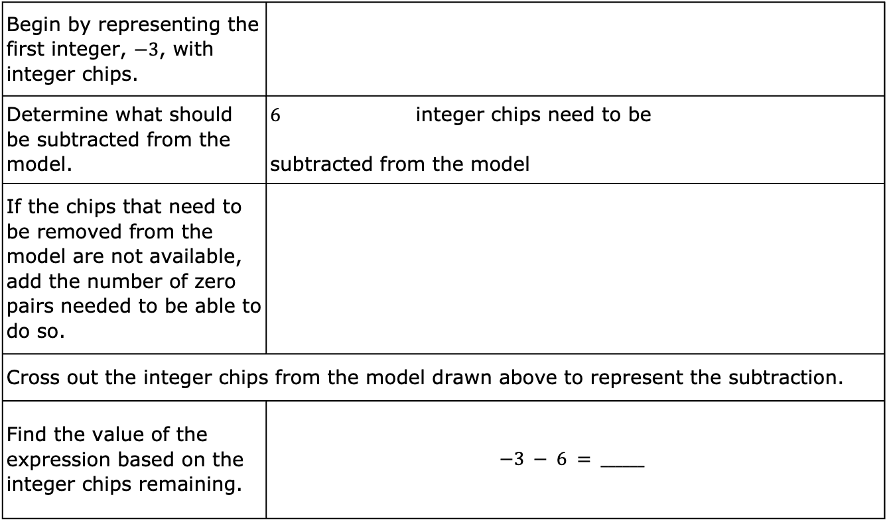
Complete the table to show how $(−3)−6$ can be represented using integer chips.
Begin by representing the first integer, $−3$, with integer chips.
Determine what should be subtracted from the model. | $6$ integer chips need to be subtracted from the model
If the chips that need to be removed from the model are not available, add the number of zero pairs needed to be able to do so.
Cross out the integer chips from the model drawn above to represent the subtraction.
Find the value of the expression based on the integer chips remaining. | $$−3 − 6 = ______$$
volume 2, pg. 35

Slide 17
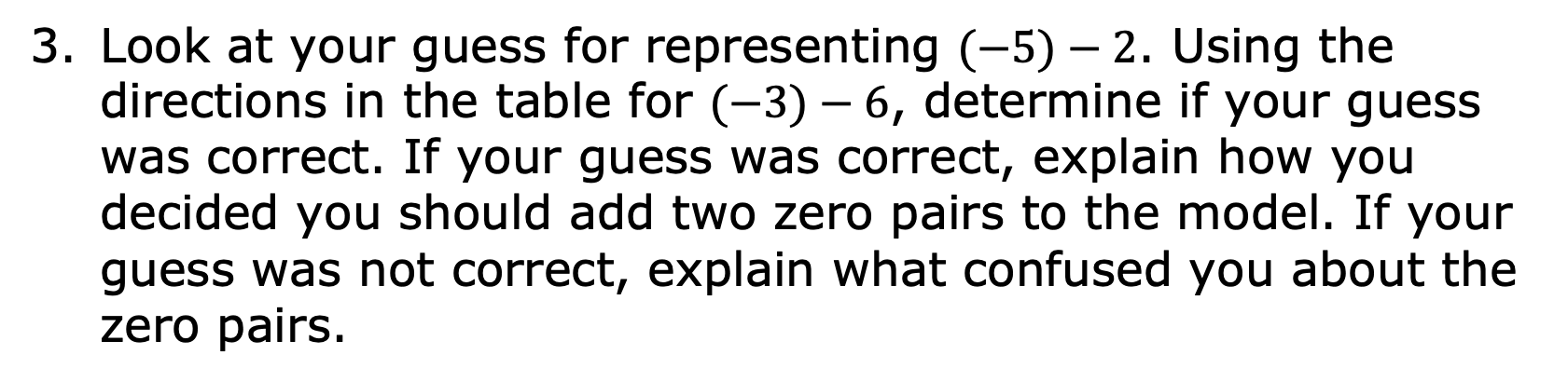
Look at your guess for representing $(−5)−2$. Using the directions in the table for $(−3)−6$, determine if your guess was correct. If your guess was correct, explain how you decided you should add two zero pairs to the model. If your guess was not correct, explain what confused you about the zero pairs.
volume 2, pg. 35

Slide 18
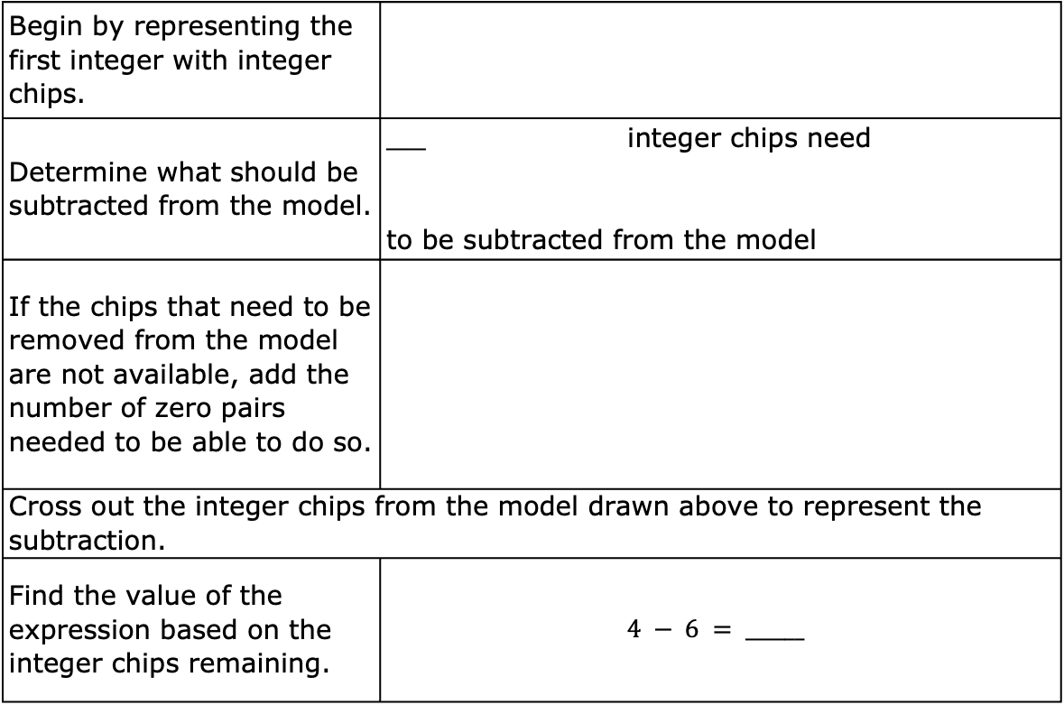
Complete the table to show how $4−6$ can be represented using integer chips.
Begin by representing the first integer with integer chips.
Determine what should be subtracted from the model. | $____$ integer chips need to be subtracted from the model
If the chips that need to be removed from the model are not available, add the number of zero pairs needed to be able to do so.
Cross out the integer chips from the model drawn above to represent the subtraction.
Find the value of the expression based on the integer chips remaining. | $$4 − 6 = ______$$
volume 2, pg. 35

Slide 19

Guided Practice
volume 2, pg. 36

Slide 20

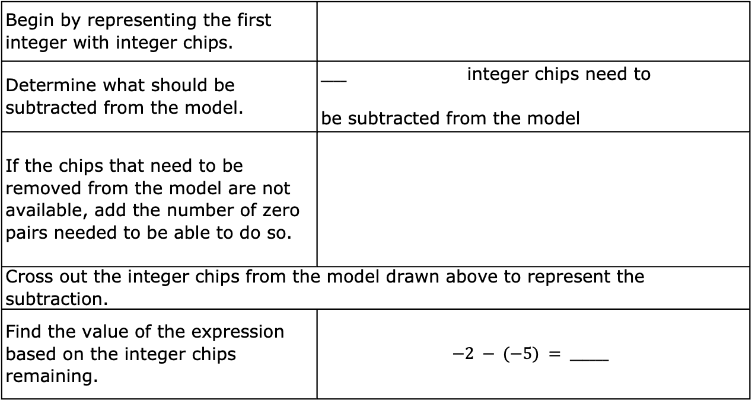
7.7.4 Guided Practice: Subtraction with Integer Chips
Complete the table to show how $(−2)−(−5)$ can be represented using integer chips.
Begin by representing the first integer with integer chips.
Determine what should be subtracted from the model. | $____$ integer chips need to be subtracted from the model
If the chips that need to be removed from the model are not available, add the number of zero pairs needed to be able to do so.
Cross out the integer chips from the model drawn above to represent the subtraction.
Find the value of the expression based on the integer chips remaining. | $$−2 − (−5) = ______$$
volume 2, pg. 36

Slide 21
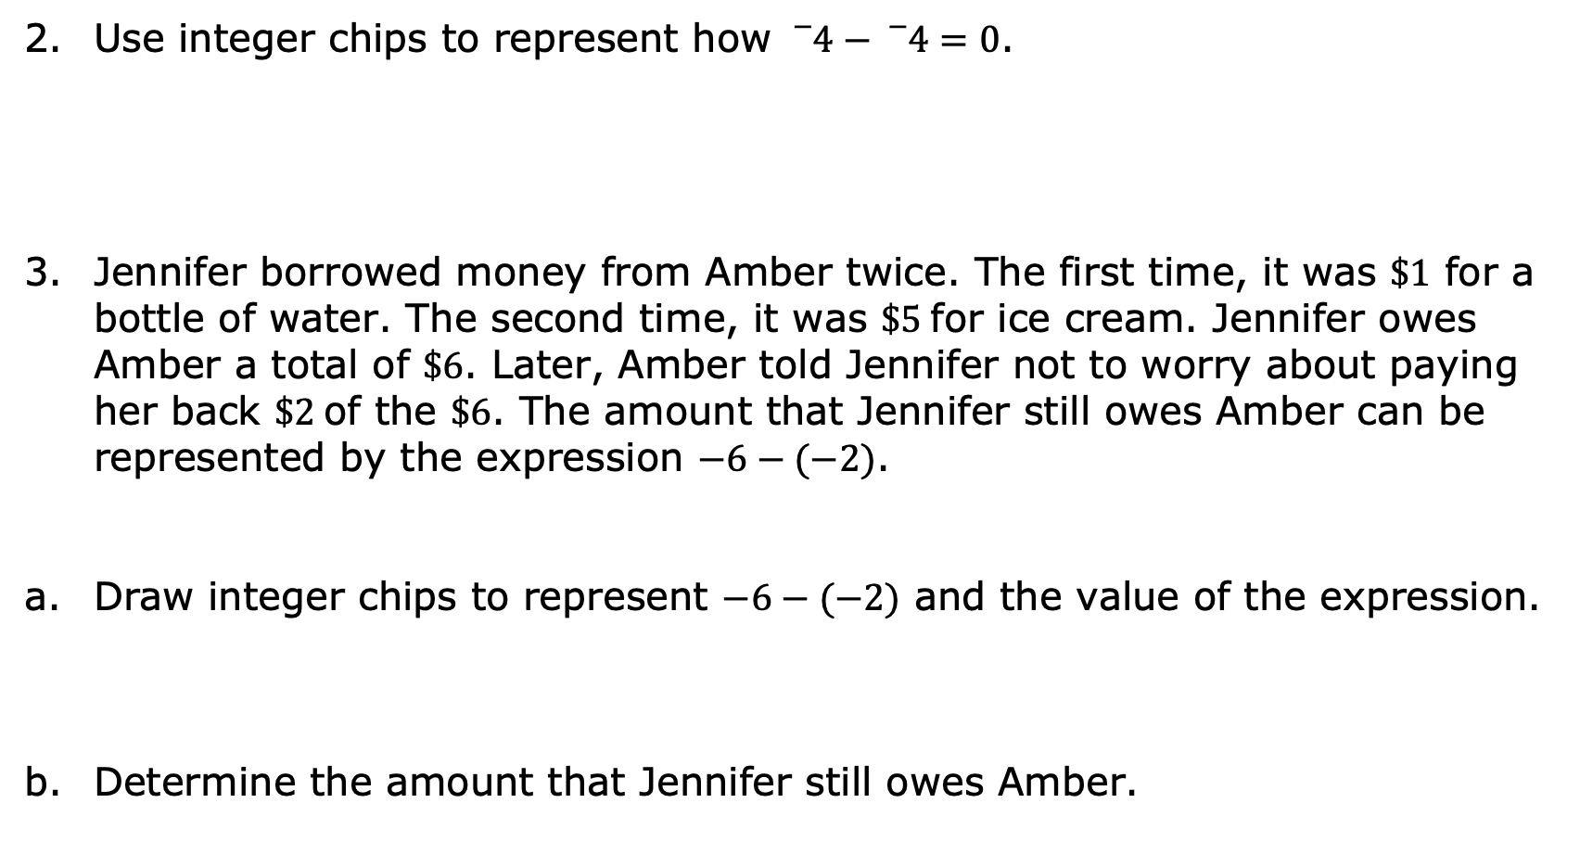
Use integer chips to represent how ${}_{}^{−}4−{}_{}^{−}4=0$.
Jennifer borrowed money from Amber twice. The first time, it was $\$1$ for a bottle of water. The second time, it was $\$5$for ice cream. Jennifer owes Amber a total of $\$6$. Later, Amber told Jennifer not to worry about paying her back $\$2$of the $\$6$. The amount that Jennifer still owes Amber can be represented by the expression $−6−(−2)$.
Draw integer chips to represent $−6−(−2)$ and the value of the expression.
Determine the amount that Jennifer still owes Amber.
volume 2, pg. 36

Slide 22

Your Turn
volume 2, pg. 37

Slide 23


7.7.5 Your Turn!
Use integer chips to find the value of each expression.
$−11−6$ b. $−4−(−7)$
c. $5−(−8)$ d. $9−(−3)$
e. $−1−2$ f. $−12−4$
volume 2, pg. 37

Slide 24

Wrap-Up
volume 2, pg. 37

Slide 25
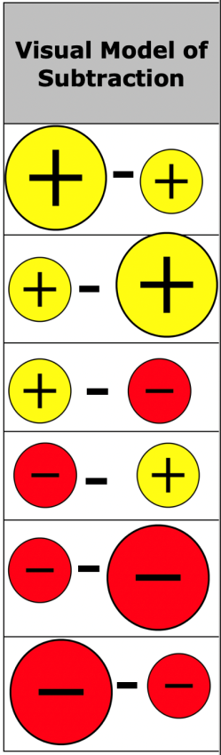
7.7.6 Wrap-Up: Cool Down
Choose two of the visual models of subtraction that you are sure will result in a positive answer.
Draw an asterisk (*) next to both in the table.
Give an example of them below.
volume 2, pg. 37

Slide 26
Choose one visual model that is a challenge for you.
Draw an exclamation point (!) next to it in the table.
Explain using an example why it is a challenge.
volume 2, pg. 37

